Slide 1
Retrieval Augmented Generation (RAG)
Sources:
* Mohit Iyyer’s advanced NLP’s slides from UMass.
* Y. Gao, et al. "Retrieval-augmented generation for large language models: A survey." arXiv preprint arXiv:2312.10997 (2023).

Slide 2

Background
Drawbacks of LLMs
  Hallucination
  Outdated information
  Low efficiency in parameterizing knowledge
  Lack of in-depth knowledge in specialized domains
  Weak inferential capabilities
Practical Requirements of Application
  Domain-specific accurate answering
  Frequent updates of data
  Traceability and explainability of generated content
  Controllable cost
  Privacy protection of data
Draw by DALL·E-3

Slide 3


BERT
(teacher): 24 layer Transformer
barbershop: 54%
barber: 20%
salon: 6%
stylist: 4%
…
Bob went to the <MASK> to get a buzz cut

Slide 4
World knowledge is implicitly encoded in BERT’s parameters! (e.g., that barbershops are places to get buzz cuts)
BERT
(teacher): 24 layer Transformer
barbershop: 54%
barber: 20%
salon: 6%
stylist: 4%
…
Bob went to the <MASK> to get a buzz cut

Slide 5
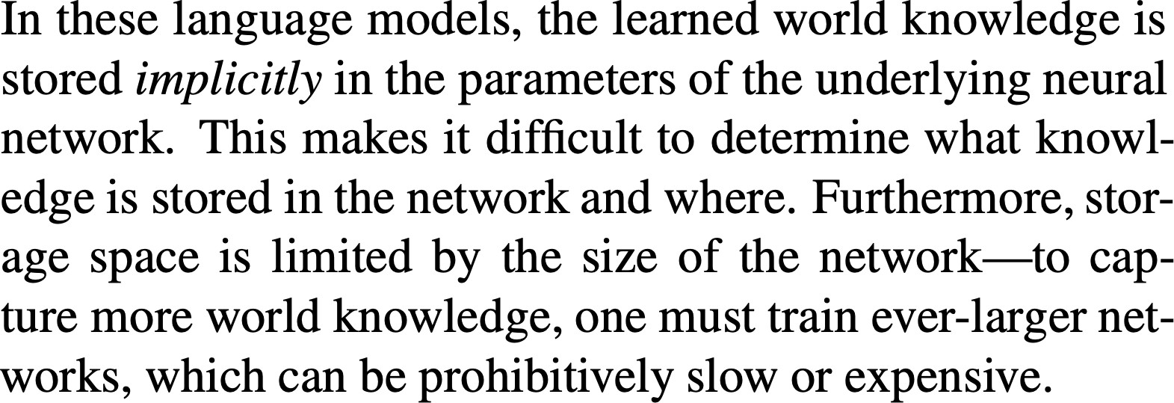
Guu et al., 2020 (“REALM”)

Slide 6
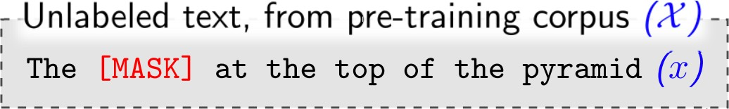

Slide 7
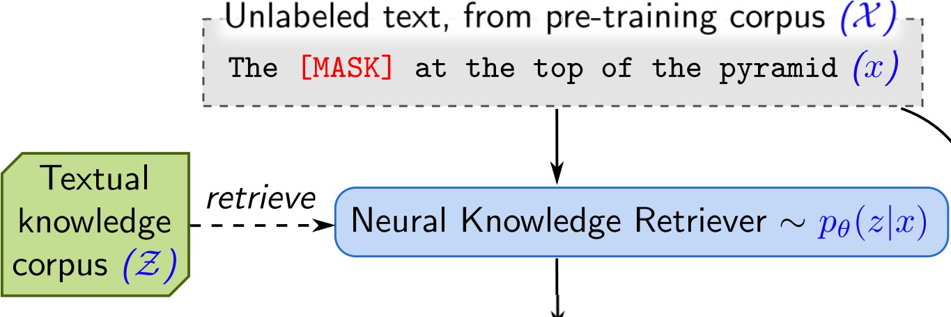

Slide 8
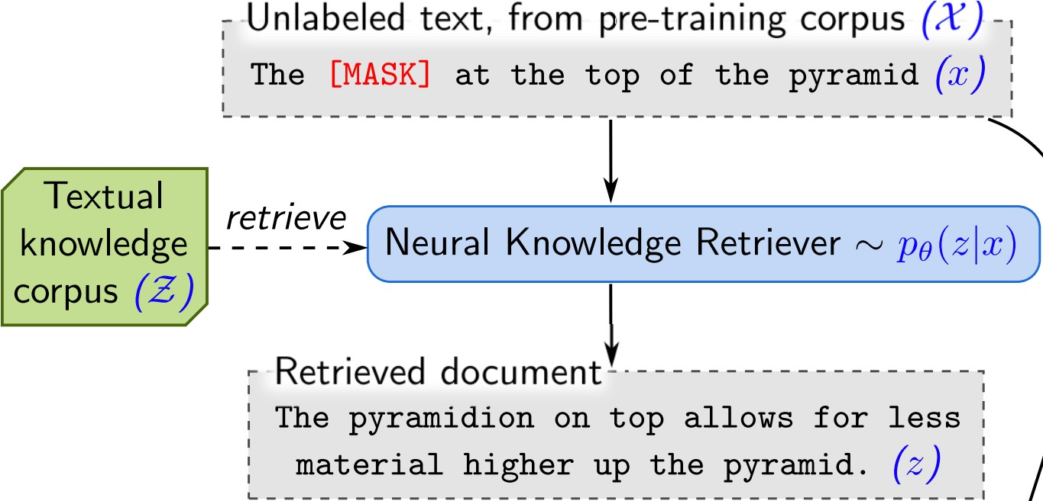

Slide 9
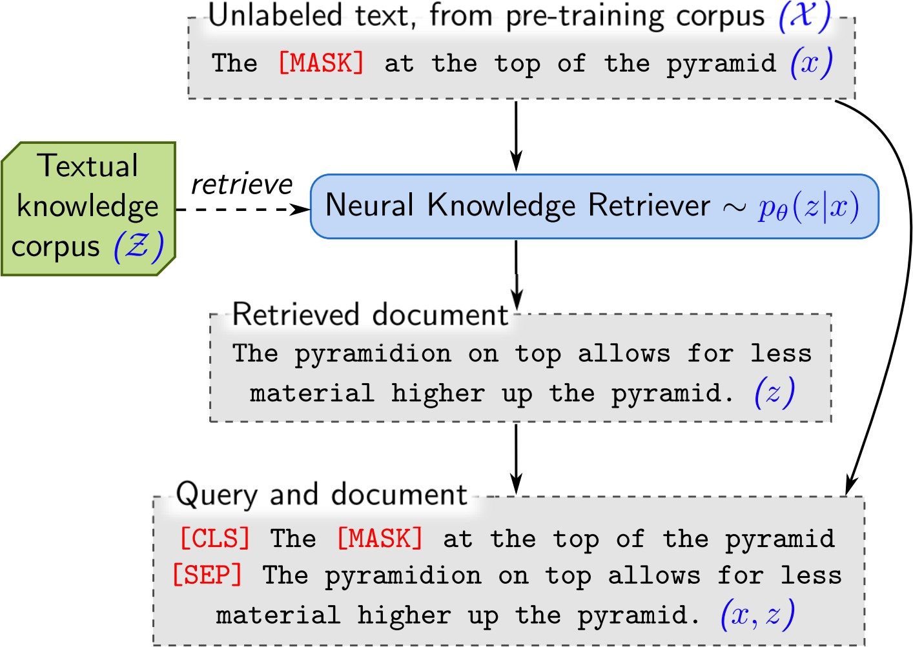

Slide 10
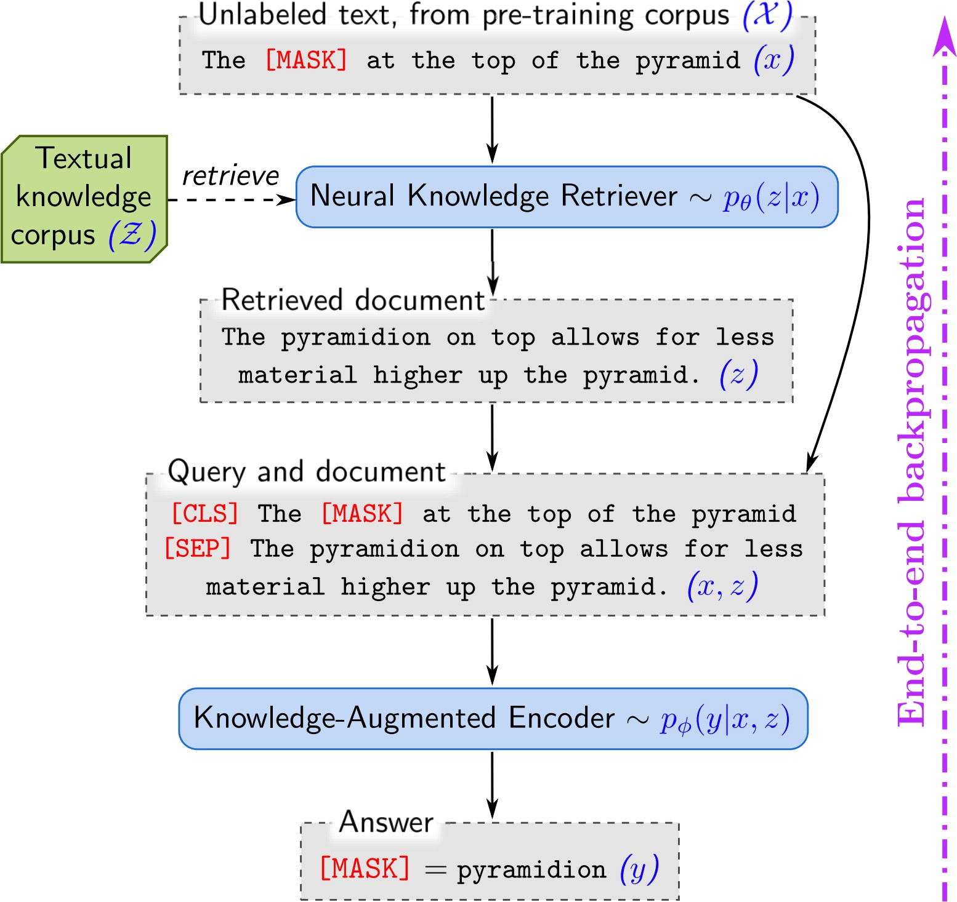

Slide 11
How can we train this retriever???

Slide 12
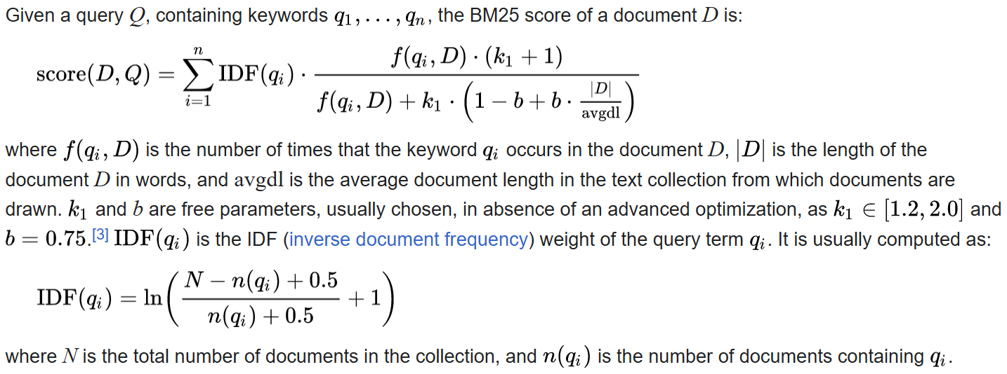
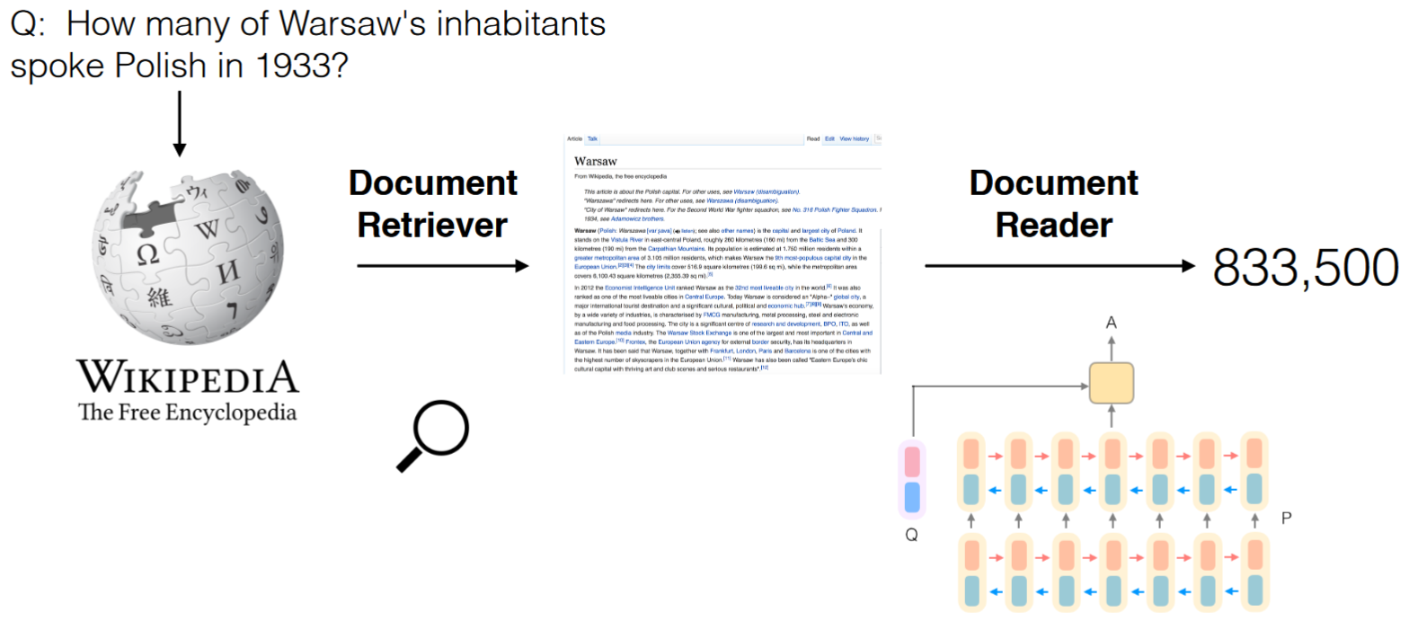
Sparse Retrieval
TF-IDF and BM25 (Robertson, Spärck Jones, et al.)
Used in DrQA (Chen et al 2017)

Slide 13
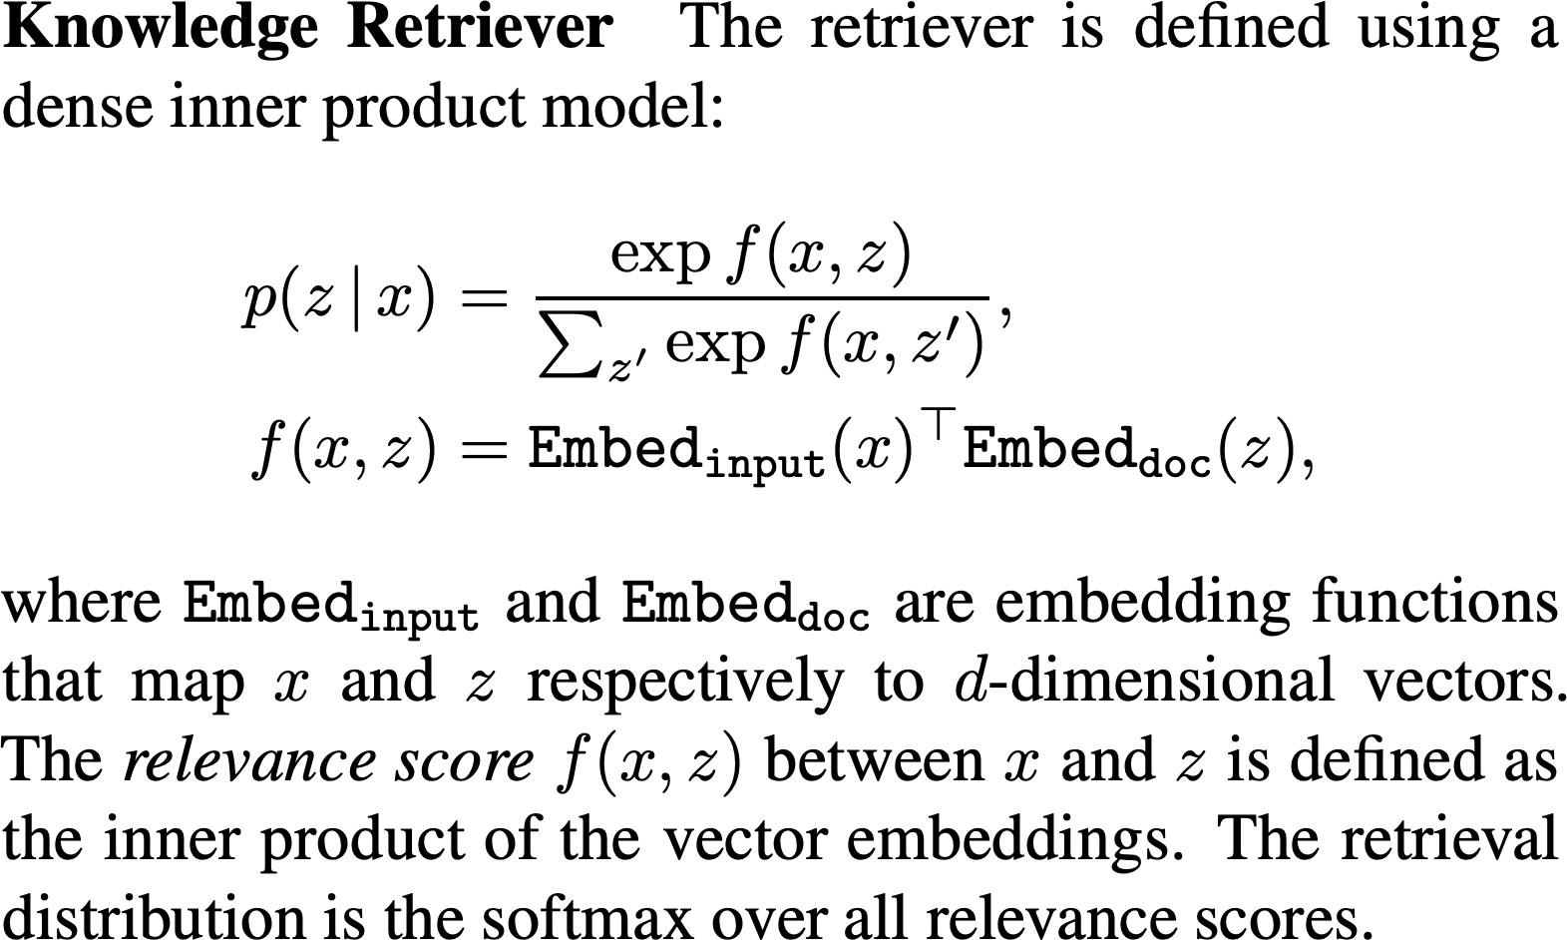
Dense Retriever

Slide 14
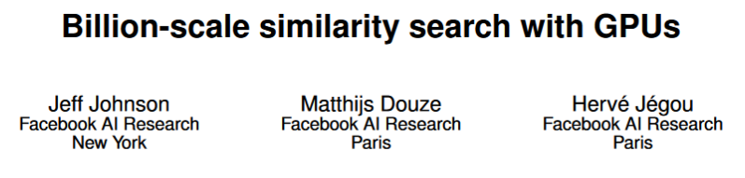
Idea: A vector database
Based on “semantic similarity” (i.e., cosine score between two embeddings)
Powered by FAISS (Johnson et al. 2019)
https://github.com/facebookresearch/faiss

Slide 15
Evaluation on open-domain QA
Unlike SQuAD-style QA, in open-domain QA we are only given a question, not a supporting document that is guaranteed to contain the answer
Open-domain QA generally has a large retrieval component, since the answer to any given question could occur anywhere in a large collection of documents

Slide 16
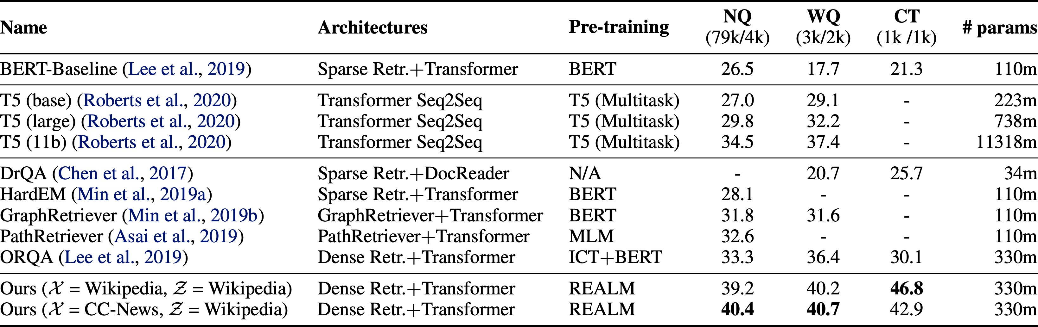

Slide 17
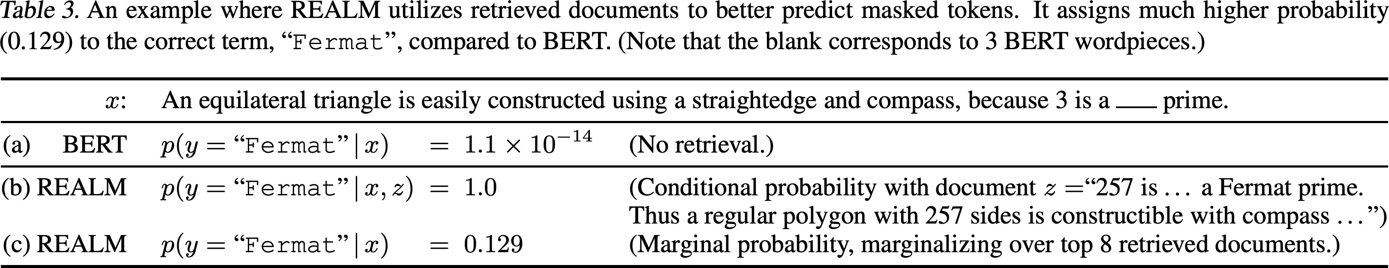

Slide 18
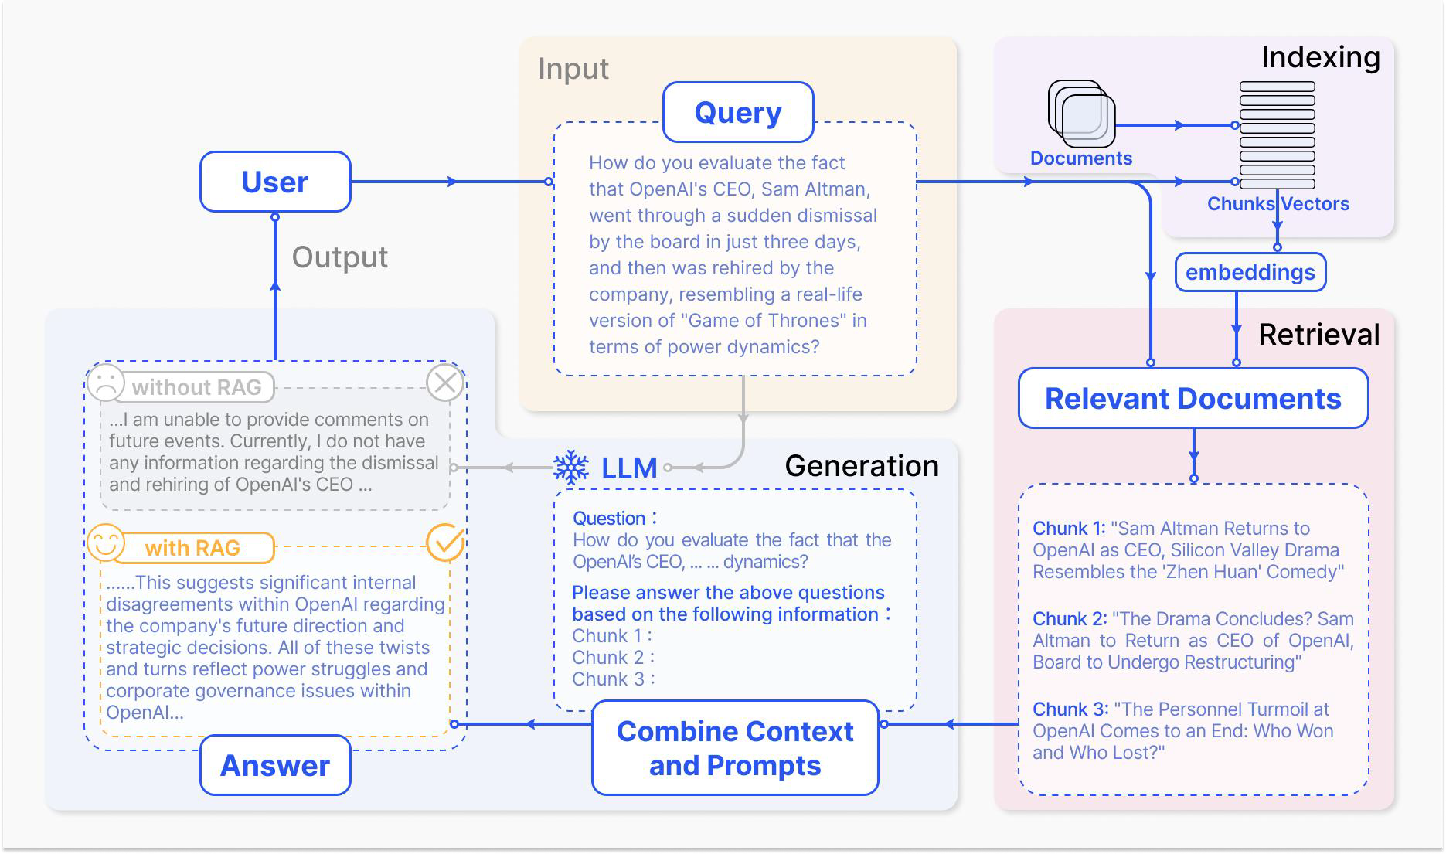
Retrieval-Augmented Generation (RAG)
When answering questions or generating text, it first retrieves relevant information from a large number of documents, and then LLMs generates answers based on this information.
By attaching a external knowledge base, there is no need to retrain the entire large model for each specific task.
The RAG model is especially suitable for knowledge-intensive tasks.
A typical case of RAG

Slide 19
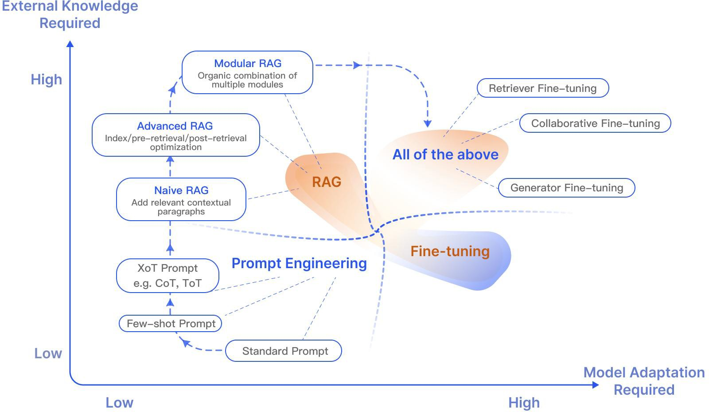
Symbolic Knowledge or Parametfic Knowledge
Ways to optimize LLMs.
Prompt Engineering
Retrieval-Augmented Generation
Instruct / Fine-tuning
A typical case of RAG

Slide 20
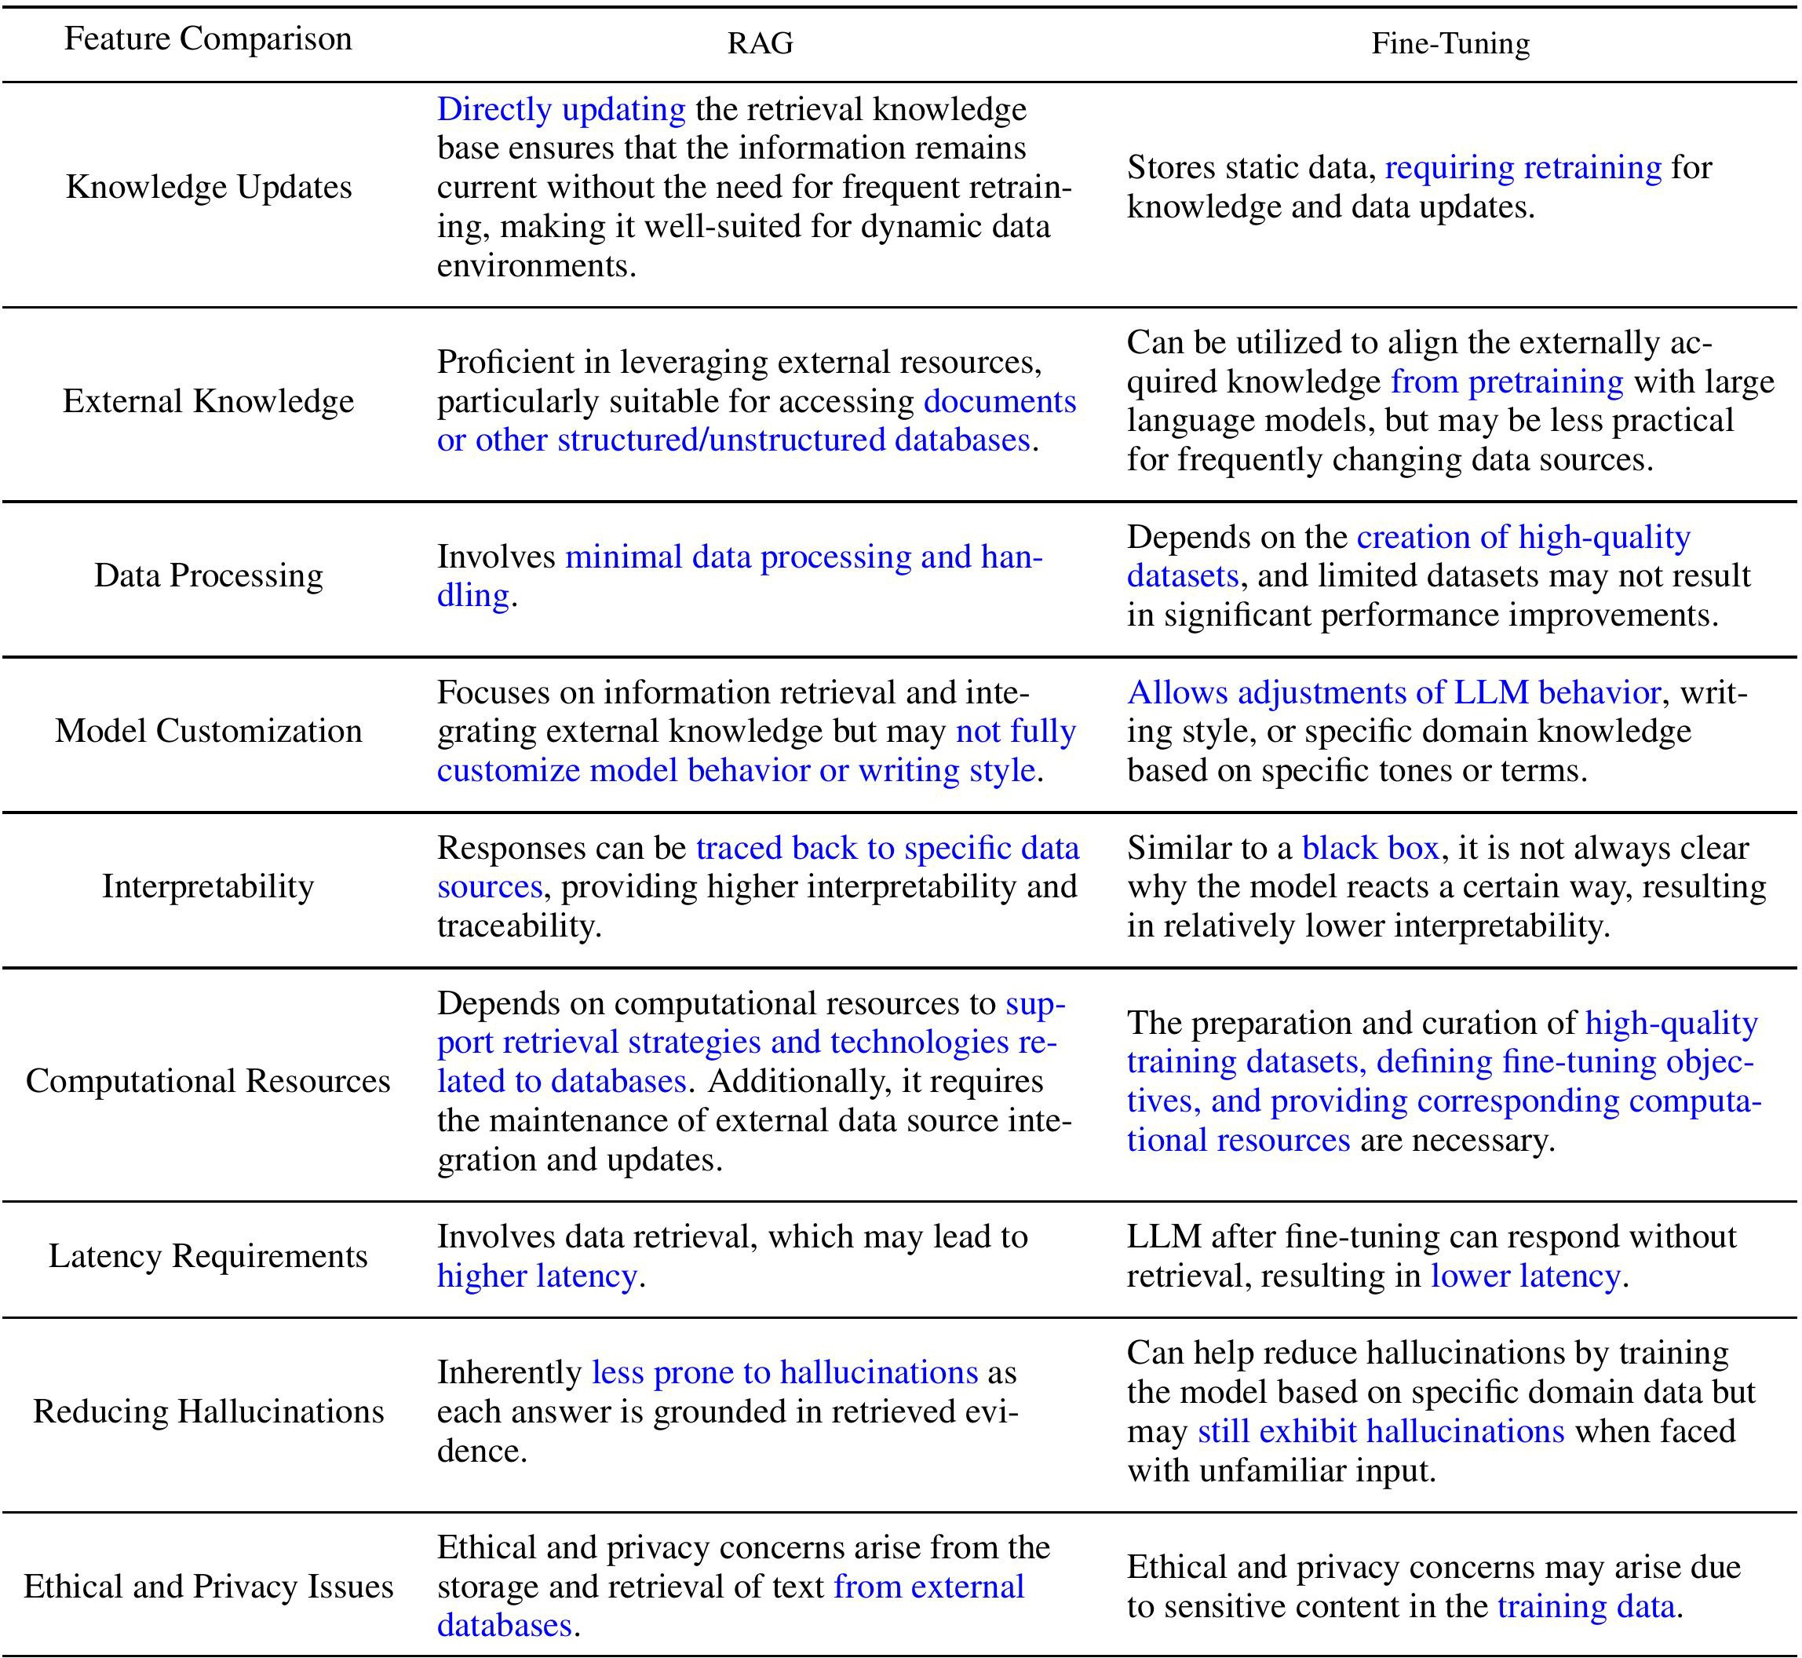
RAG vs Fine-tuning

Slide 21
RAG Applications
Scenarios where RAG is applicable:
  Long-tail distribution of data
  Frequent knowledge updates
  Answers requiring verification and traceability
  Specialized domain knowledge
  Data privacy preservation
Q&A
RETRO (Borgeaud et al2021) REALM (Gu et al, 2020)
ATLAS (lzacard et al, 2023)
Fact Checking
RAG (Lewis et al, 2020) ATLAS (lzacard et al, 2022) Evi. Generator (Asai et al, 2022a)
Dialog
Blender Bot 3 (Shuster et al.2022)
Internet-augmented generation
(Komeili et a., 2022)
Summary
FLARE (Jiang et al, 2023)
Machine Translation
kNN-MT (Khandelwal et al., 2020)TRIME-MT (Zhong et al., 2022)
Code Generation
DocPrompting (Zhou et al., 2023
Natural ProverWelleck et al., 2022)
Natural Language Inference
kNN-Prompt (Shi et al., 2022) NPM (Min et al., 2023)
Sentiment analysis
k NN- Prompt (Shi et al., 2022)NPM (Min et al., 2023)
Commonsense reasoning
Raco (Yu et al, 2022)

Slide 22
RAG Paradigms Shifting

Slide 23
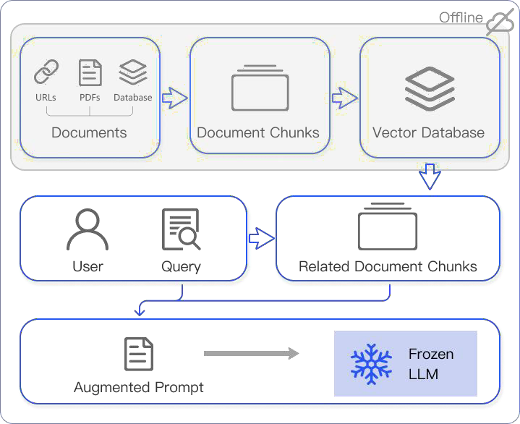
Naïve RAG
Step 1: Indexing
  Divide the document into even chunks, each chunk being a piece of the original text.
  Using the encoding model to generate an embedding for each chunk.
  Store the Embedding of each block in the vector database.
Step 2: Retrieval
  Retrieve the k-most relevant documents using vector similarity search.
Step 3: Generation
  The original query and the retrieved text are combined and input into a LLM to get the final answer
Naive RAG
Advanced RAG
Modular RAG

Slide 24
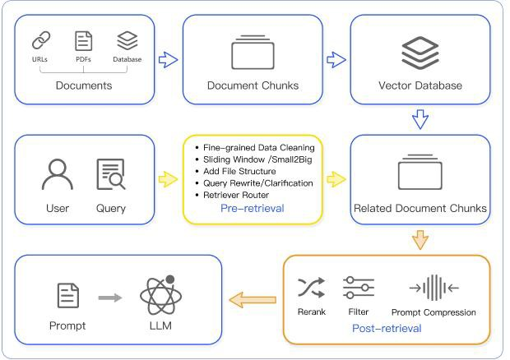
Advanced RAG
Index Optimization → Pre-Retrieval Process → Retrieval →
Post-Retrieval Process→ Genaration
Naive RAG
Optimizing Data Indexing: sliding window, fine-grained segmentation, adding metadata
Pre-Retrieval Process: retrieve routes, summaries, rewriting, and confidence judgment
Post-Retrieval Process: reorder, filter content retrieval
Advanced RAG
Modular RAG

Slide 25
Modular RAG
Modules
Pattern
Naive RAG
Search
Naive RAG
Read Retrieve Generate
Aggregation Read
Rewrite
Predict
DSP (2022)
Demonstrate Search Predict
Generate
Advanced RAG
Rerank
RAG
Retrieve
Filter
Rewrite- Retrieve-Read (2023)
Rewrite
Retrieve
Read
Demonstrate
Generate
Retrieve-then- read (2023)
Retrieve Read Generate
Reflect
Modular RAG

Slide 26
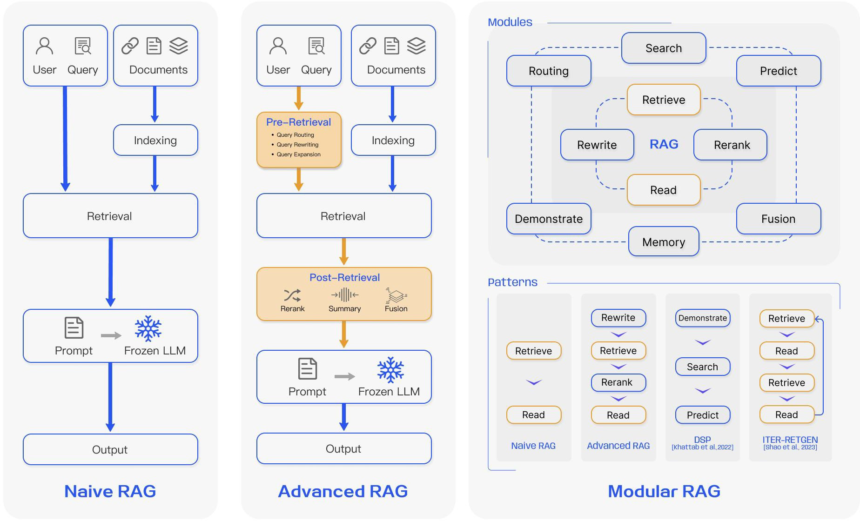
Comparison of RAG Paradigms

Slide 27
The three key questions of RAG
How to use the retrieved information?
What to retrieve ?
When to retrieve?
Token
Phrase
Chunk
Paragraph
Entity
Knowledge graph
Single search
Each token
Every N tokens
Adaptive search
Input/Data Layer
Model/Intermediate Layer
Output/Prediction Layer
Augmentation stage：
Retrieval choice:
Model Collaboration
Generation choice:
Other Issues
Pre-training
Fine-tuning
Inference
BERT
RoBERTa
BGE
......
GPT
Llama
T5
......
Scale selection

Slide 28
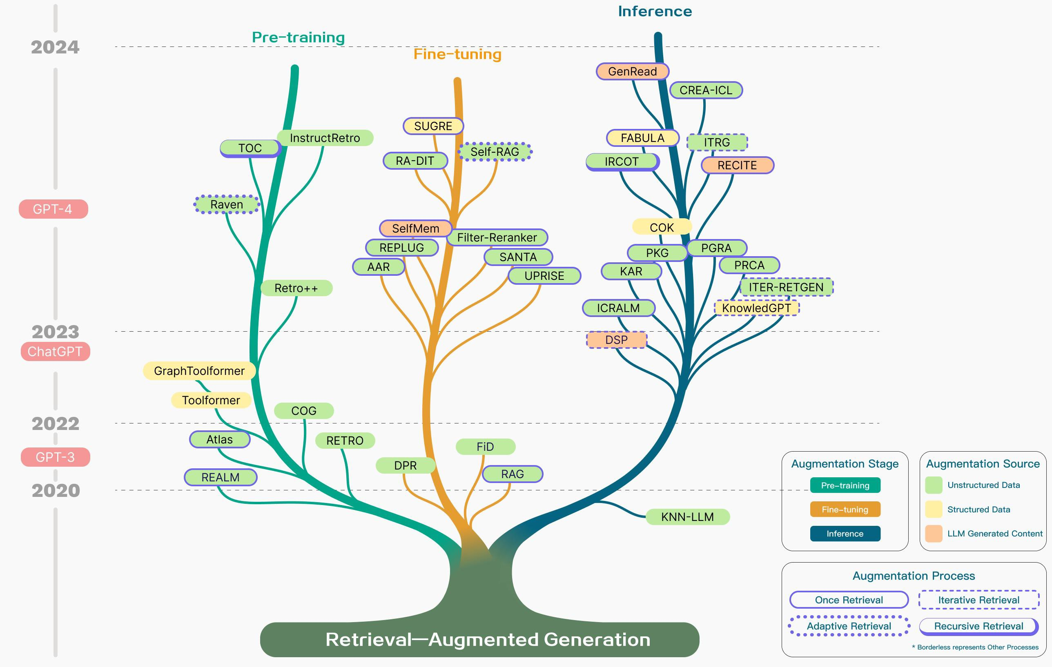
Overview of RAG Development

Slide 29
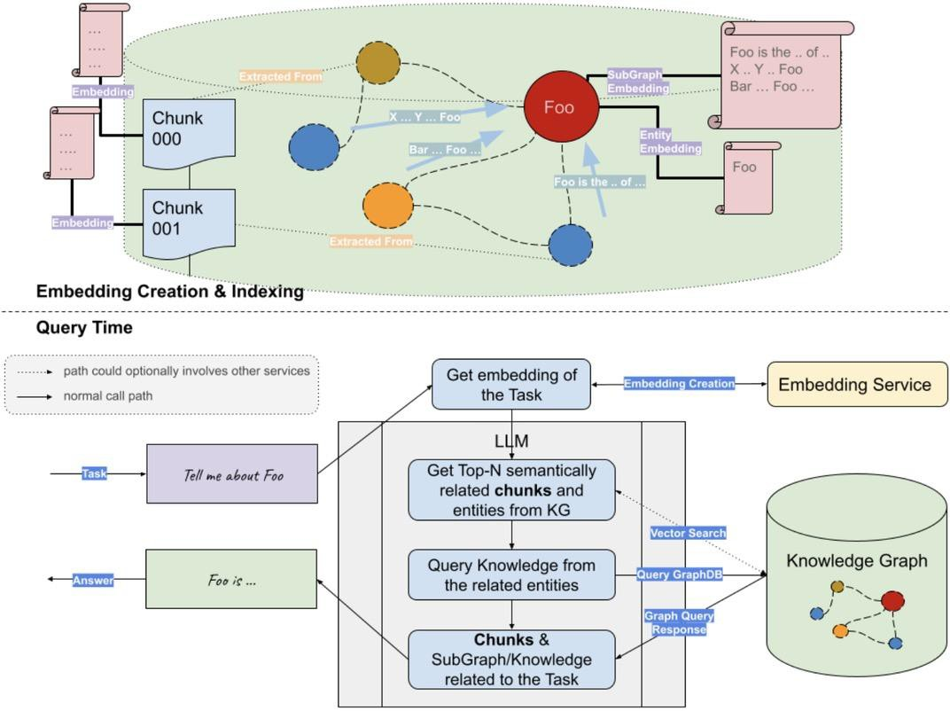
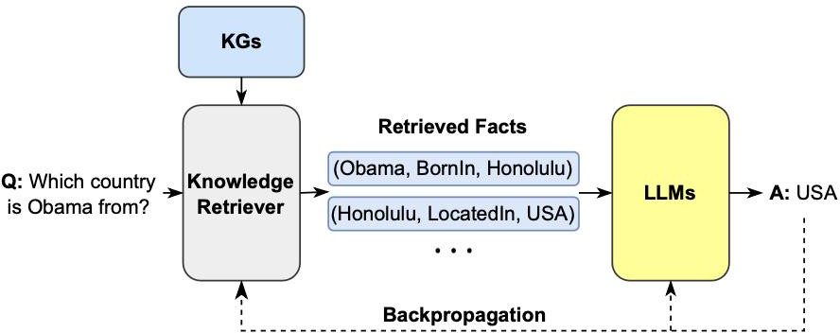
Techniques for Better RAG: KG as a Retrieval Data Source
GraphRAG
  Extract entities from the user's input query, then construct a subgraph to form context, and finally feed it into the large model for generation.
Implementation
  Use LLM (or other models) to extract key entities from the question.
  Retrieve subgraphs based on entities, delving to a certain depth, such as 2 hops or even more.
  Utilize the obtained context to generate answers through LLM.

Slide 30
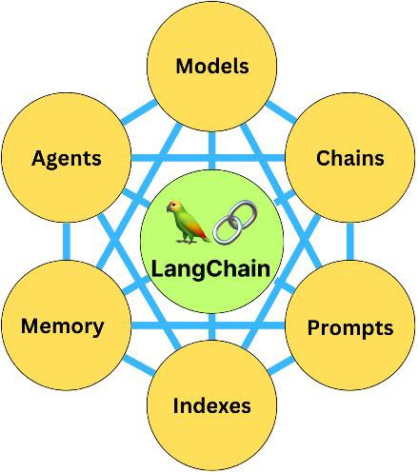
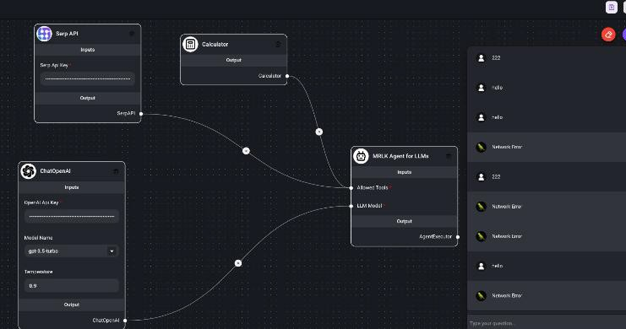
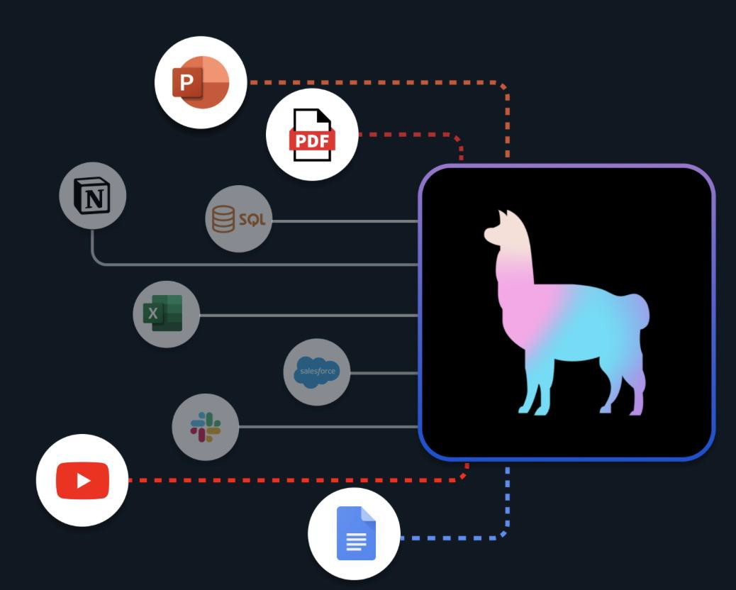
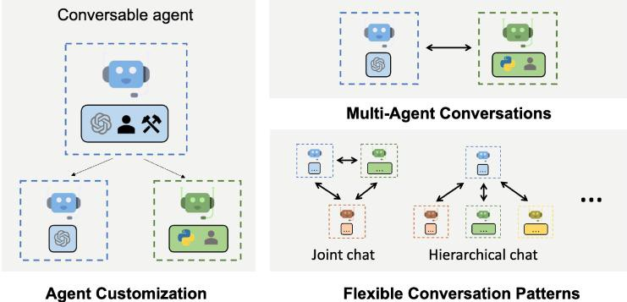
Existing Tech Stack for RAG
Name
Pros
Cons
LangChain
Modular, full-featured
Inconsistent behavior, API conceals details, complexity and low flexibility.
LangChain
FlowiseAI
LlamaIndex
Focus on RAG
Requires combination use, low customization.
FlowiseAI
Easy to get started, visualized workflows.
Does not support complex scenarios.
AutoGen
Adapts to multi-agent scenarios.
Low efficiency, requires multiple rounds of dialogue.
LlamaIndex
AutoGen

